Slide 1
Chapter 4
SQL: Data Definition, Constraints, and Basic Queries and Updates

Slide 2
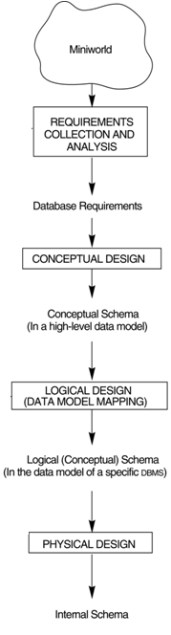
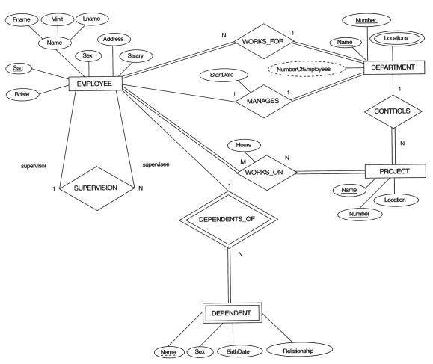
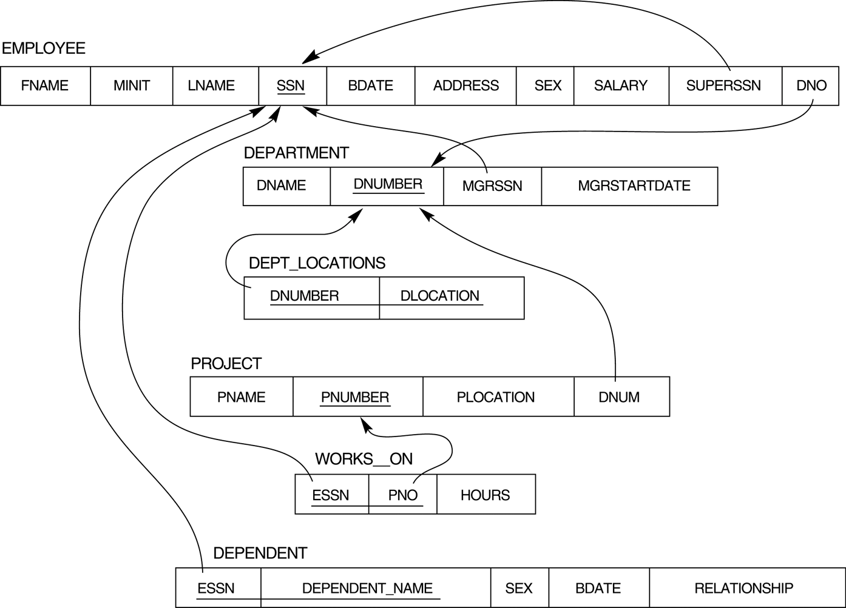

Main phases of database system design
Database Requirements
Construct DB
Design DB
Define DB
Load DB
Mini-world
DB
DBMS

Slide 3
Construction and Operation
SQL DML
AP
Canned St.
Command
…
AP
DBA
construct
manipulate
1. Define DB
(SQL DDL)
2. Load data
DB
User
DB System
SQL (Ch.4, 5)
Data Definition Language
- CREATE, DROP, ALTER
SQL (Ch.4, 5)
Data Manipulation Language
Query: SELECT
Update: INSERT, DELETE, UPDATE

Slide 4
Chapter Outline
SQL Data Definition and Data Types
Specifying Constraints in SQL
Basic Retrieval Queries in SQL
INSERT, DELETE, and UPDATE Statements in SQL
Additional Features of SQL

Slide 5
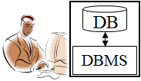
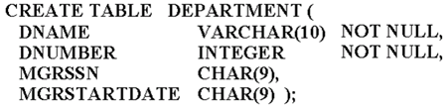
Define Database Schema
CREATE SCHEMA COMPANY AUTHORIZATION ‘JSmith’;
define

Slide 6

CREATE TABLE
Specifies a new base relation by
giving it a name, and
specifying each of its attributes and their data types (e.g., INTEGER, FLOAT, DECIMAL(i,j), CHAR(n), VARCHAR(n))
A constraint NOT NULL may be specified on an attribute CREATE TABLE DEPARTMENT ( DNAME VARCHAR(10) NOT NULL, DNUMBER INT NOT NULL, MGRSSN CHAR(9), MGRSTARTDATE CHAR(9) );

Slide 7
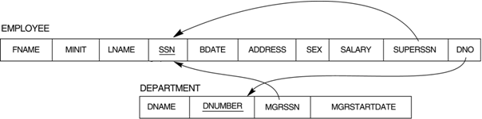
CREATE TABLE
In SQL2, can use the CREATE TABLE command for specifying the primary key attributes, secondary keys, and referential integrity constraints (foreign keys).
Key attributes can be specified via the PRIMARY KEY and UNIQUE phrases
CREATE TABLE DEPARTMENT
( DNAME VARCHAR(10) NOT NULL, DNUMBER INT NOT NULL, MGRSSN CHAR(9), MGRSTARTDATE CHAR(9),
PRIMARY KEY (DNUMBER), UNIQUE (DNAME), FOREIGN KEY (MGRSSN) REFERENCES EMPLOYEE(SSN) );

Slide 8
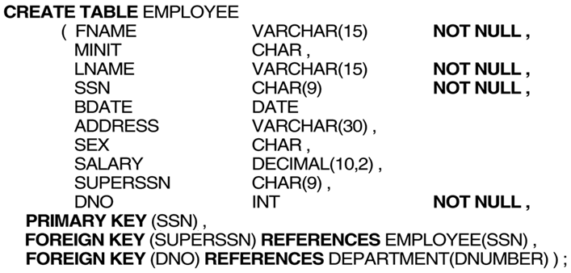

Slide 9
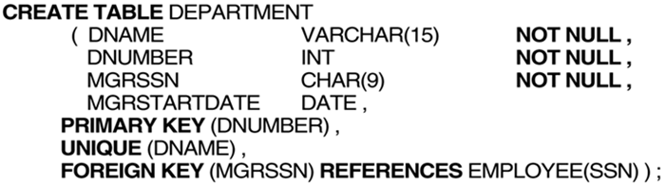
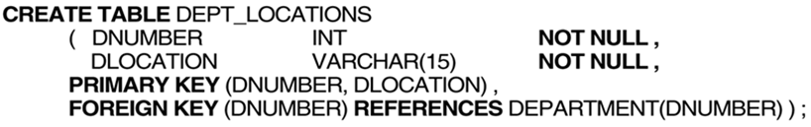

Slide 10
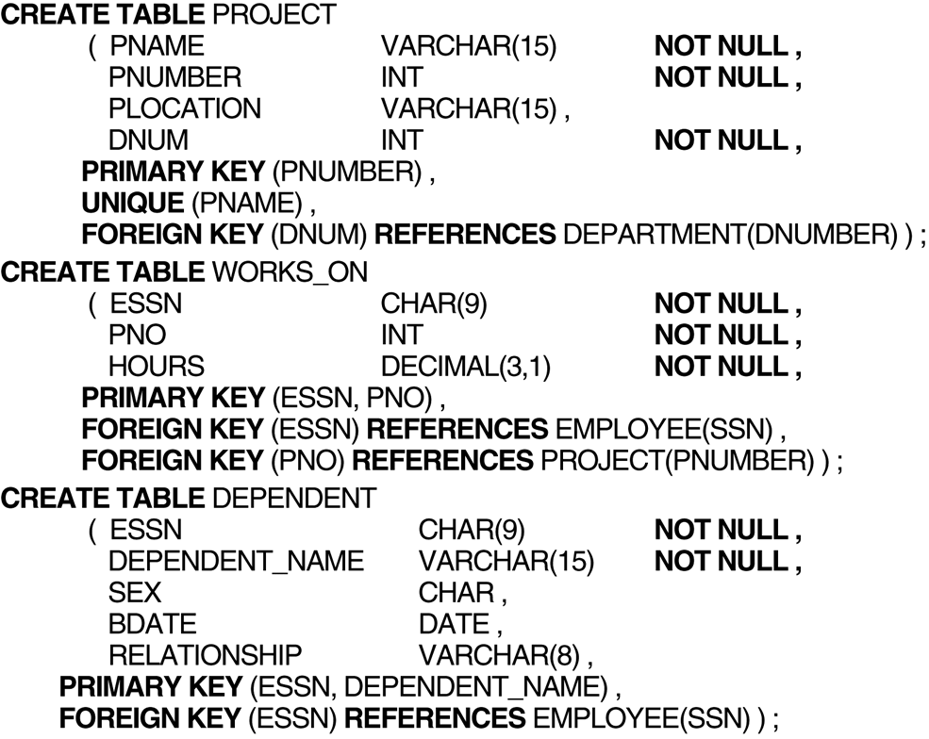
FIGURE (continued)

Slide 11
Additional Data Types in SQL2 and SQL-99
Has DATE, TIME, and TIMESTAMP data types
DATE:
Made up of year-month-day in the format yyyy-mm-dd
TIME:
Made up of hour:minute:second in the format hh:mm:ss
TIME(i):
Made up of hour:minute:second plus i additional digits specifying fractions of a second
format is hh:mm:ss:ii...i
TIMESTAMP:
Has both DATE and TIME components
INTERVAL:
Specifies a relative value rather than an absolute value
Can be DAY/TIME intervals or YEAR/MONTH intervals
Can be positive or negative when added to or subtracted from an absolute value, the result is an absolute value

Slide 12
Specifying Constraints in SQL
Specifying attribute constraints
DNUMBER INT NOT NULL CHECK (DNUMBER > 0 AND DNUMBER < 21)
REFERENTIAL INTEGRITY OPTIONS
can specify RESTRICT, CASCADE, SET NULL or SET DEFAULT on referential integrity constraints (foreign keys)
CREATE TABLE EMPLOYEE (ENAME VARCHAR(30) NOT NULL, ESSN CHAR(9), BDATE DATE, DNO INT DEFAULT 1, SUPERSSN CHAR(9),
PRIMARY KEY (ESSN), FOREIGN KEY (DNO) REFERENCES DEPARTMENT (DNUMBER) ON DELETE SET DEFAULT ON UPDATE CASCADE, FOREIGN KEY (SUPERSSN) REFERENCES EMPLOYEE (ESSN) ON DELETE SET NULL ON UPDATE CASCADE);

Slide 13
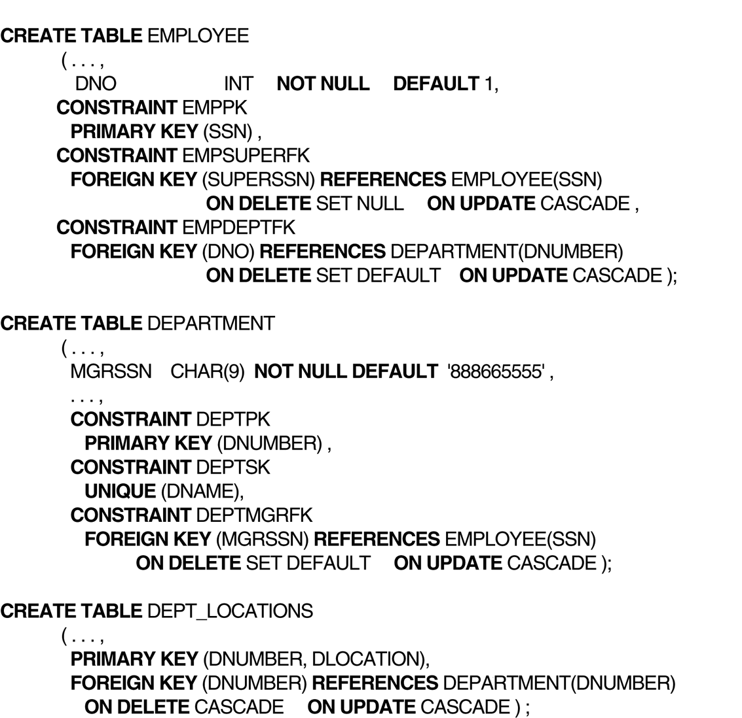
Default attribute values and referential triggered actions can be specified in SQL.

Slide 14
Basic Retrieval Queries in SQL
…
AP
DBA
construct
DML
manipulate
1. Define DB
(SQL DDL)
2. Load data
DB
User
DB System
SQL (Ch.4, 5)
Data Manipulation Language
Query: SELECT
Update: INSERT, DELETE, UPDATE
SQL (Ch.4, 5)
Data Definition Language
- CREATE, DROP, ALTER

Slide 15
Relational Database Schema: Company

Slide 16
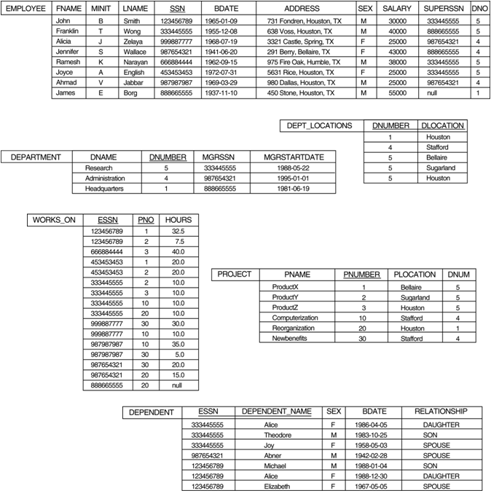
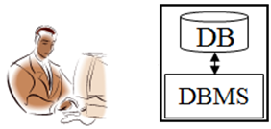
How to retrieve data from the populated database?
SQL
SELECT BDATE, ADDRESS FROM EMPLOYEE WHERE FNAME='John' AND MINIT='B’ AND LNAME='Smith’

Slide 17
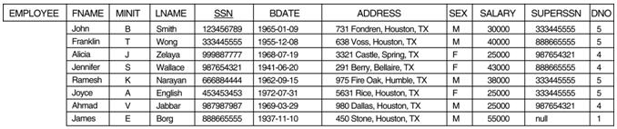
Retrieval Queries in SQL
Basic form of the SQL SELECT statement is called a mapping or a SELECT-FROM-WHERE block
SELECT <attribute list>
FROM <table list>
WHERE <condition>
<attribute list> is a list of attribute names whose values are to be retrieved by the query
<table list> is a list of the relation names required to process the query
<condition> is a conditional (Boolean) expression that identifies the tuples to be retrieved by the query
SELECT FNAME, LNAME, ADDRESS FROM EMPLOYEE WHERE DNO = 5

Slide 18

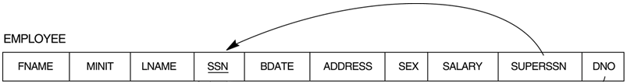
Simple SQL Queries
Basic SQL queries correspond to using the SELECT, PROJECT, and JOIN operations of the relational algebra
Example of a simple query on one relation
Query 0: Retrieve the birthdate and address of the employee whose name is 'John B. Smith'.
Q0: SELECT BDATE, ADDRESS FROM EMPLOYEE WHERE FNAME='John' AND MINIT='B' AND LNAME='Smith'
Similar to a SELECT-PROJECT pair of relational algebra operations; the SELECT-clause specifies the projection attributes and the WHERE-clause specifies the selection condition
However, the result of the query may contain duplicate tuples

Slide 19
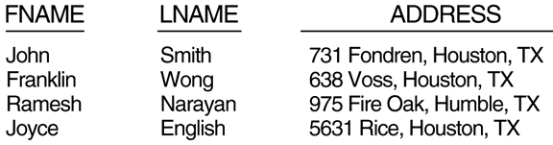
SQL Queries with Join
Query 1: Retrieve the name and address of all employees who work for the 'Research' department.
Q1: SELECT FNAME, LNAME, ADDRESS (姓名 地址) FROM EMPLOYEE, DEPARTMENT WHERE DNAME=‘Research’ AND DNUMBER=DNO(找研究部門) 透過DNO找到DNAME
(DNAME = 'Research') is a selection condition
(DNUMBER = DNO) is a join condition (牽涉join速度較慢)
5
Research 5

Slide 20
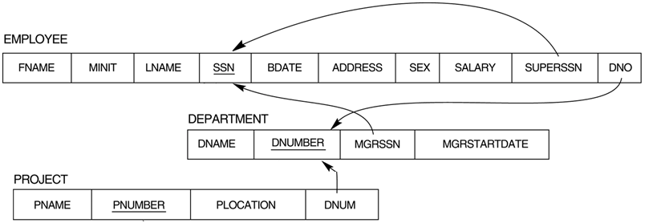
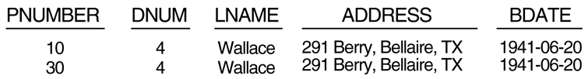
SQL Queries with Two Join
Query 2: For every project located in ‘Stafford’, list the project number, the controlling department number, and the department manager‘s last name, address, and birthdate.
Q2: SELECT PNUMBER, DNUM, LNAME, BDATE, ADDRESS FROM PROJECT, DEPARTMENT, EMPLOYEE WHERE DNUM=DNUMBER AND MGRSSN=SSN AND PLOCATION=‘Stafford’ (專案在這做)
In Q2, there are two join conditions
The join condition DNUM=DNUMBER relates a project to its controlling department
The join condition MGRSSN=SSN relates the controlling department to the employee who manages that department
負責的主管的 名字生日地址
Stafford 4

Slide 21
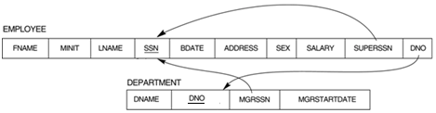
Aliases, * and DISTINCT, Empty WHERE-clause
In SQL, we can use the same name for two (or more) attributes as long as the attributes are in different relations
A query that refers to two or more attributes with the same name must qualify the attribute name with the relation name by prefixing the relation name to the attribute name
SELECT FNAME, LNAME, ADDRESS, DNAME
FROM EMPLOYEE, DEPARTMENT WHERE EMPLOYEE.DNO = DEPARTMENT.DNO

Slide 22
ALIASES
Some queries need to refer to the same relation twice
In this case, aliases are given to the relation name
Query 8: For each employee, retrieve the employee‘s name, and the name of his or her immediate supervisor. Q8: SELECT E.FNAME, E.LNAME, S.FNAME, S.LNAME FROM EMPLOYEE E S (兩個TABLE都是EMPLOYEE 要相等) WHERE E.SUPERSSN=S.SSN (主管的SSN要相等)
In Q8, the alternate relation names E and S are called aliases or tuple variables for the EMPLOYEE relation
We can think of E and S as two different copies of EMPLOYEE; E represents employees in role of supervisees and S represents employees in role of supervisors
Aliasing can also be used in any SQL query for convenience Can also use the AS keyword to specify aliases
Q8: SELECT E.FNAME, E.LNAME, S.FNAME, S.LNAME FROM EMPLOYEE AS E, EMPLOYEE AS S WHERE E.SUPERSSN=S.SSN
E
S

Slide 23
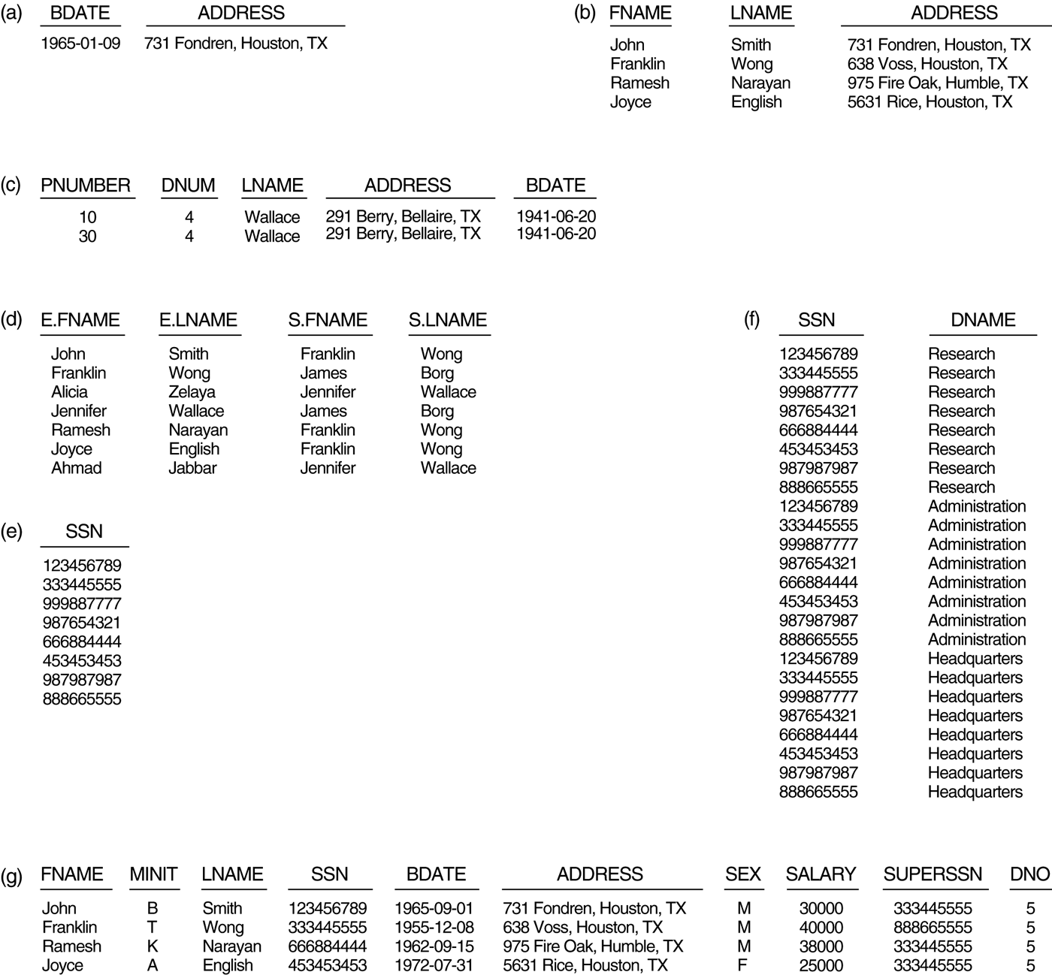
FIGURE Results of SQL queries when applied to the COMPANY database (a) Q0. (b) Q1. (c) Q2. (d) Q8. (e) Q9. (f) Q10. (g) Q1C.

Slide 24
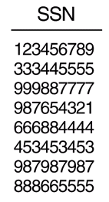
UNSPECIFIED WHERE-clause
A missing WHERE-clause indicates no condition; hence, all tuples of the relations in the FROM-clause are selected
This is equivalent to the condition WHERE TRUE
Query 9: Retrieve the SSN values for all employees.
Q9: SELECT SSN FROM EMPLOYEE
If more than one relation is specified in the FROM-clause and there is no join condition, then the CARTESIAN PRODUCT of tuples is selected
Q10: SELECT SSN, DNAME (員工編號 對 部門名稱) FROM EMPLOYEE, DEPARTMENT
It is extremely important not to overlook specifying any selection and join conditions in the WHERE-clause; otherwise, incorrect and very large relations may result
8 tuples (一筆資料對上3筆)
3 tuples (所以一共24筆)

Slide 25
USE OF *
To retrieve all the attribute values of the selected tuples, a * is used, which stands for all the attributes (*表示全選) Examples:
Q1C: SELECT * FROM EMPLOYEE WHERE DNO=5 Q1D: SELECT * FROM EMPLOYEE, DEPARTMENT WHERE DNAME='Research' AND DNO=DNUMBER

Slide 26
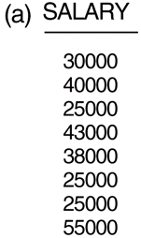
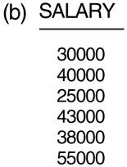
USE OF DISTINCT
SQL does not treat a relation as a set; duplicate tuples can appear
To eliminate duplicate tuples in a query result, the keyword DISTINCT is used
For example, the result of Q11 may have duplicate SALARY values whereas Q11A does not have any duplicate values
Q11: SELECT SALARY FROM EMPLOYEE
Q11A: SELECT DISTINCT SALARY FROM EMPLOYEE

Slide 27
SET OPERATIONS
SQL has directly incorporated some set operations (集合運算)
There is a union operation (UNION), and in some versions of SQL there are set difference (MINUS) and intersection (INTERSECT) operations
The resulting relations of these set operations are sets of tuples; duplicate tuples are eliminated from the result
The set operations apply only to union compatible relations:
1. The two relations must have the same attributes.
2. The attributes must appear in the same order.
R
A1 | A2 | A3 | A4
R UNION S ?
R(A1, A3) MINUS S(A1, A3) ?
R(A2, A4) INTERSECT S(A4) ?
S
A1 | A2 | A3 | A4

Slide 28
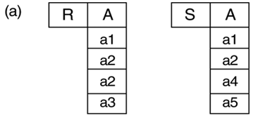
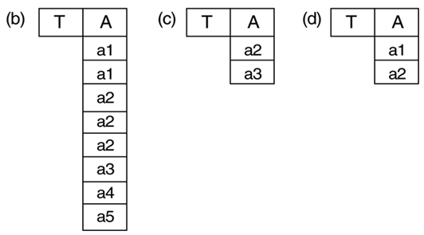
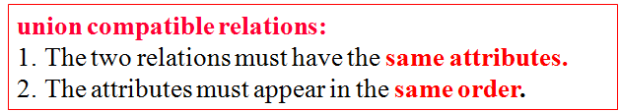
FIGURE The results of SQL multiset operations.
(a) Two tables, R(A) and S(A).
R(A) UNION ALL S(A)
R(A) INTERSECT ALL S(A)
R(A) EXCEPT ALL S(A)
Use the keyword ALL for multiset operations, which will preserve duplicate tuples.

Slide 29
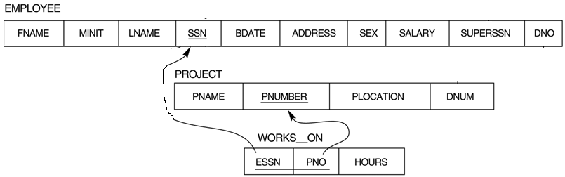
SET OPERATIONS (cont.)
Query 4: Make a list of all project numbers for projects that involve an employee whose last name is 'Smith' as a worker or as a manager of the department that controls the project. Q4: (SELECT PNAME FROM PROJECT, DEPARTMENT, EMPLOYEE WHERE DNUM=DNUMBER AND MGRSSN=SSN AND LNAME='Smith') UNION
(SELECT PNAME FROM PROJECT, WORKS_ON, EMPLOYEE WHERE PNUMBER=PNO AND ESSN=SSN AND LNAME='Smith')
Union compatible?
Smith
Smith

Slide 30
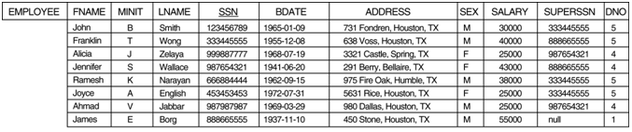
SUBSTRING COMPARISON
The LIKE comparison operator is used to compare partial strings. Two reserved characters are used:
'%' (or '*' in some implementations) replaces an arbitrary number of characters, and
'_' replaces a single arbitrary character
Query 12: Retrieve all employees whose address is in Houston, Texas. Here, the value of the ADDRESS attribute must contain the substring ‘Houston,TX’. Q12: SELECT FNAME, LNAME FROM EMPLOYEE WHERE ADDRESS LIKE ‘%Houston, TX%’ (TX是地名)

Slide 31
SUBSTRING COMPARISON
Query 12A: Retrieve all employees who were born during the 1950s. Here, '5' must be the 3th character of the string (according to our format for date), so the BDATE value is '_ _ 5_ _ _ _ _ _ _', with each underscore as a place holder for a single arbitrary character. Q12A: SELECT FNAME, LNAME FROM EMPLOYEE WHERE BDATE LIKE '_ _5_ _ _ _ _ _ _’
The LIKE operator allows us to get around the fact that each value is considered atomic and indivisible; hence, in SQL, character string attribute values are not atomic
BDATE
1955-12-08

Slide 32
ARITHMETIC OPERATIONS
The standard arithmetic operators '+', '-'. '*', and '/' (for addition, subtraction, multiplication, and division, respectively) can be applied to numeric values in an SQL query result
Query 13: Show the effect of giving all employees who work on the ‘ProductX’ project a 10% raise. Q13: SELECT FNAME, LNAME, 1.1*SALARY (顯示加薪，但selec不動到db) FROM EMPLOYEE, WORKS_ON, PROJECT (實質上沒有加薪) WHERE SSN=ESSN AND PNO=PNUMBER AND PNAME='ProductX’

Slide 33
ORDER BY 排序
The ORDER BY clause is used to sort the tuples in a query result based on the values of some attribute(s)
Query 15: Retrieve a list of employees and the projects each works in, ordered by the employee‘s department, and within each department ordered alphabetically by employee last name. Q15: SELECT DNAME, LNAME, FNAME, PNAME FROM DEPARTMENT, EMPLOYEE, WORKS_ON, PROJECT WHERE DNUMBER=DNO AND SSN=ESSN AND PNO=PNUMBER ORDER BY DNAME, LNAME(先排部門名稱 由小到大)
The default order is in ascending(小到大) order of values
Keyword DESC if we want a descending order;
Keyword ASC can be used to explicitly specify ascending order, even though it is the default

Slide 34

Summary of Basic SQL Retrieval Queries
A basic retrieval query in SQL:
SELECT <attribute list> FROM <table list> [ WHERE <condition> ] [ ORDER BY <attribute list> ]

Slide 35
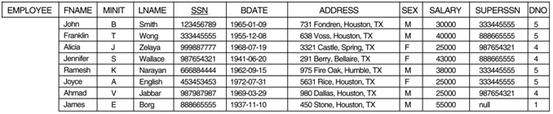
Specifying Updates in SQL
There are three SQL commands to modify the database;
INSERT
DELETE
UPDATE

Slide 36

INSERT
Used to add one or more tuples to a relation
Attribute values should be listed in the same order as the attributes were specified in the CREATE TABLE command
Example: U1: INSERT INTO EMPLOYEE VALUES ('Richard','K','Marini', '653298653', '30-DEC-52', '98 Oak Forest,Katy,TX', 'M', 37000,'987654321', 4 )
An alternate form of INSERT specifies explicitly the attribute names that correspond to the values in the new tuple
Attributes with NULL values can be left out
Example: Insert a tuple for a new EMPLOYEE for whom we only know the FNAME, LNAME, and SSN attributes. U1A: INSERT INTO EMPLOYEE (FNAME, LNAME, SSN) VALUES ('Richard', 'Marini', '653298653')

Slide 37
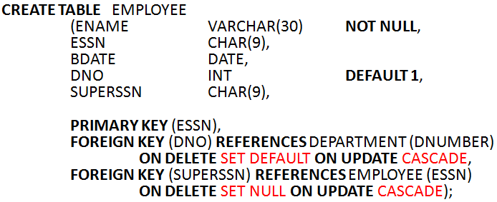
INSERT of Multiple Tuples
Important Note:
Only the constraints specified in the DDL commands are automatically enforced by the DBMS when updates are applied to the database

Slide 38
INSERT of Multiple Tuples
Another variation of INSERT allows insertion of multiple tuples resulting from a query into a relation
Example: Suppose we want to create a temporary table that has the name, number of employees, and total salaries for each department. A table DEPTS_INFO is created by U3A, and is loaded with the summary information retrieved from the database by the query in U3B. U3A: CREATE TABLE DEPTS_INFO (DEPT_NAME VARCHAR(10), NO_OF_EMPS INTEGER, TOTAL_SAL INTEGER); U3B: INSERT INTO DEPTS_INFO (DEPT_NAME, NO_OF_EMPS, TOTAL_SAL) SELECT DNAME, COUNT (*), SUM (SALARY) FROM DEPARTMENT, EMPLOYEE WHERE DNUMBER=DNO GROUP BY DNAME ;

Slide 39
DELETE
Removes tuples from a relation
Includes a WHERE-clause to select the tuples to be deleted
Tuples are deleted from only one table at a time (unless CASCADE is specified on a referential integrity constraint)
The number of tuples deleted depends on the number of tuples in the relation that satisfy the WHERE-clause
Referential integrity should be enforced
U4A: DELETE FROM EMPLOYEE WHERE LNAME='Brown’

Slide 40
DELETE (cont.)
U4B: DELETE FROM EMPLOYEE WHERE SSN='123456789’ U4C: DELETE FROM EMPLOYEE WHERE DNO = 5 U4D: DELETE FROM EMPLOYEE
A missing WHERE-clause specifies that all tuples in the relation are to be deleted; the table then becomes an empty table

Slide 41
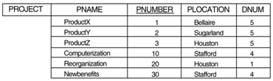
UPDATE
Used to modify attribute values of one or more selected tuples
A WHERE-clause selects the tuples to be modified
An additional SET-clause specifies the attributes to be modified and their new values
Each command modifies tuples in the same relation
Referential integrity should be enforced
Example: Change the location and controlling department number of project number 10 to 'Bellaire' and 5, respectively. U5: UPDATE PROJECT SET PLOCATION = 'Bellaire', DNUM = 5 WHERE PNUMBER=10

Slide 42
UPDATE (cont.)
Example: Give all employees in department 5 a 10% raise in salary. U6: UPDATE EMPLOYEE SET SALARY = SALARY *1.1 WHERE DNO = 5
In this request, the modified SALARY value depends on the original SALARY value in each tuple
The reference to the SALARY attribute on the right of = refers to the old SALARY value before modification
The reference to the SALARY attribute on the left of = refers to the new SALARY value after modification

